Slide 1
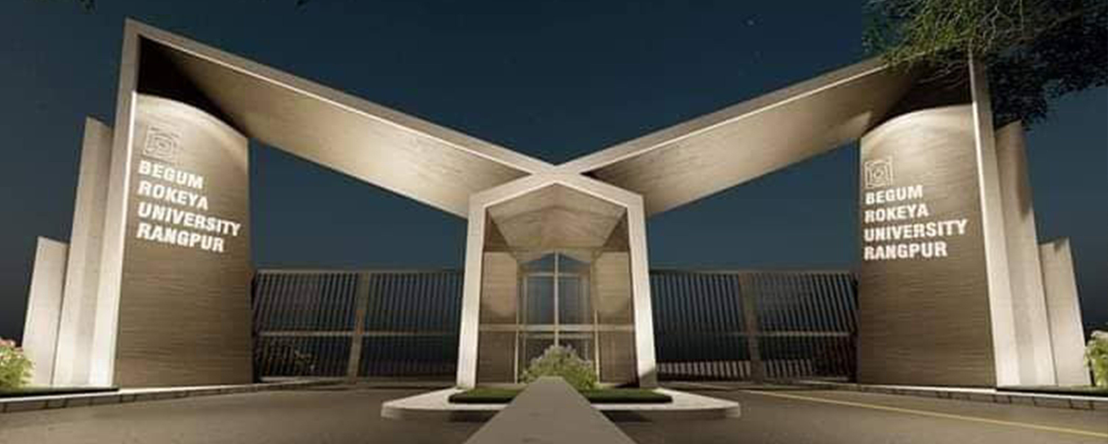

Slide 2
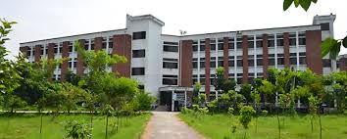
A Presentation On
BEGUM ROKEYA UNIVERSITY, RANGPUR
Presentation
Md. Limon MIa
Department Of Economics
Begum Rokeya University, Rangpur

Slide 3

Introduction:
Begum Rokeya University, Rangpur (BRUR) is a public research university in Bangladesh. It was established in 2008 and is the only university in the Rangpur Division. The university is named after Begum Rokeya, a feminist writer and social worker.

Slide 4

Prominent person Brur
Vc: Professor Dr. Md. Showkat Ali
Office email: office.vc@brur.ac.bd
Cell phone: +8801313013200
Fax: +880521-59301
Proctor: Md. Ferdous Rahman

Slide 5
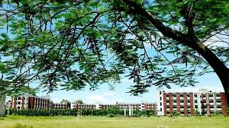
Campus:
The university is located between Rangpur Cadet College and Carmichael College in Rangpur. It covers an area of 75 acres (300,000 m²). The university has constructed four academic buildings and started classes from August 2011 in the main campus. Currently, the university has twenty-one departments and amount of student is almost seven thousand. It contains three student hallis (including two male and one female). There is a tremendous library and a cafeteria in the campus.

Slide 6
Admission:
BRUR enrolls undergraduate students. Students who want to get admission into BRUR need to pass and compete on the merit list in the admission test which is highly competitive. Admission tests are arranged by the University under authority of admission council for all faculties.

Slide 7
History:
Since 1947, a university in this region has been a long cherished dream. Finally, Dr. Fakhruddin Ahmad, in a historic cabinet meeting held in Rangpur on February 2, 2008, took the decision to establish a University in Rangpur. The Rangpur University Ordinance was approved by the cabinet on June 15, 2008. M. Lutfar Rahman was appointed the first Vice Chancellor on 20 October 2008. Two days later Hossain Zillur Rahman, the then Education and Commerce Advisor to the Caretaker Government formally inaugurated the university.

Slide 8
Residential Halls:
Halls for male students:
1. Bangabandhu Sheikh Mujibur Rahman Hall & 2.Sohid Mukhtar Ali
HallHalls for female students-
1.Sheikh Fazitunnesa Hall

Slide 9


Undergraduate Programs
B.Sc (Hons)BA (Hons.)BBA(Hom)BSS(Hons)B.Sc.(Engineering)

Slide 10


Graduate Programs
M.ScMAMILAMSSM.BA(Evening)

Slide 11
Faculties and Departments
BRUR has 23 departments
under 6 faculties:
Department of Bangla Department of English Department of History and Archaeology

Slide 12
Organizations and clubs:
1. Ronon2. Gungun3.Charan Sangskritik Kendra4. Begum Rokeya University Film Socity(BRUFS)5.Biggan Andolon Moncho6. Bangladesh Open Science Organization7. Begum Rokeya University Debating Association (BRUDA)8. Begum Rokeya University Geographers Association (BRUGA)9.Badhon10. Begum Rokeya University Photographers Club(BRUPC)11:GES Sports Club

Slide 13
Thank you

